Slide 1
VaxShield AI: Predicting Vaccine Adverse Event Seriousness using Catboost Risk
DATA 606 Capstone in Data Science
Under the guidance: Unal Sakoglu
Presented by:
Sri Spoorthy Nadella
Sarath Chandra Vundavalli
Sree Sai Sankalp Jagadam

Slide 2



The Challenge of Real-Time AE Prediction
Core Problem
Goal
Impact
Unstructured vaccine Adverse Event (AE) reports are difficult to classify in real-time.
Develop an AI system to instantly predict if a new report is Serious (Death, Hospitalization, Disability).
Provides an early warning signal for researchers and safety monitors.

Slide 3
Phase 2: Data & Baseline Modeling
Foundation
1
Data
2
Target Definition
3
Feature Engineering
Sourced and cleaned VAERS reports (2015-2025) across 4 major vaccines (COVID, FLU, VARZOS, PPV).
Defined "Serious" using clinical outcomes and the MedDRA IME List.
Used TF-IDF Vectorizer for symptom text and StandardScaler for numeric data.

Slide 4
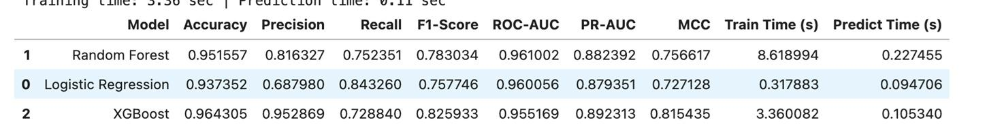
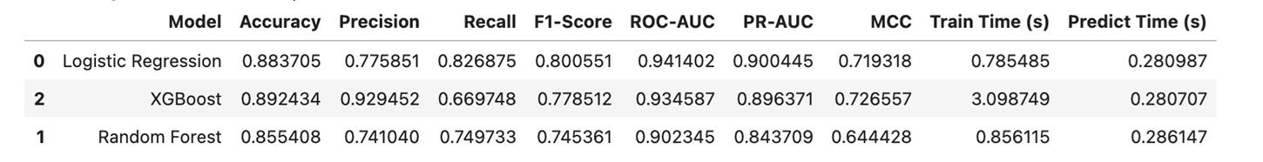
Initial Model Performance (Phase 2)
PPV
COVID
Visual Aid: Table summarizing the results of Logistic Regression, Random Forest, and XGBoost.

Slide 5
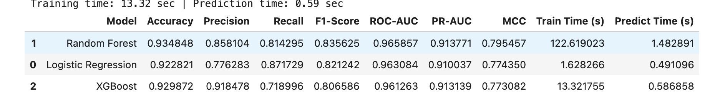
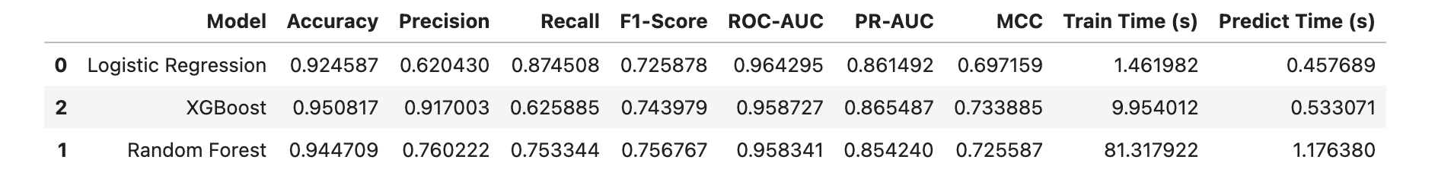
Initial Model Performance (Phase 2)
FLU
VARZOS
Visual Aid: Table summarizing the results of Logistic Regression, Random Forest, and XGBoost.

Slide 6
Transition: The Need for Advanced Methods
Conclusion: XGBoost provided a strong baseline, but its performance was limited by:
1
2
Handling of Mixed Features
Data Imbalance
Difficulty integrating text/categorical data efficiently.
Weakness in correctly identifying minority "Serious" cases (low Recall).
Action: Transition to the final phase by selecting an algorithm specialized for these challenges: CatBoost.

Slide 7



Phase 3: CatBoost Implementation
Tuning Metric
Direct Feature Input
Hyperparameters were tuned specifically to maximize PR-AUC (Precision-Recall AUC).
Training Strategy
Raw text and categorical columns were fed directly, utilizing CatBoost's native encoding.
Four specialized CatBoost classifiers were trained (one per vaccine type).

Slide 8
Literature: VAERS and Data Standards
VAERS Justification
Limitations
Clinical Standard
An essential early warning system (CDC/FDA), providing large-scale, public safety data for signal detection.
Self-reported nature means data is subject to bias and cannot determine causation.
Used MedDRA IME List for definitive, clinically sound classification of serious events.
Source: EMA IME List
Source: CDC VAERS

Slide 9
Literature: Vaccine Safety Systems
CDC Vaccine Safety & VAERS
Key Takeaways:
The Vaccine Adverse Event Reporting System (VAERS) is a passive surveillance system jointly managed by the CDC and FDA.
It collects reports of post-vaccination adverse events to identify early safety signals. Data are public and cover millions of records across all vaccine types.
Source: CDC Vaccine Safety Overview
VAERS provides the largest real-world dataset for safety signal detection. However, it is self-reported and cannot establish causality, only correlation. This motivated the need for AI-driven classification to standardize AE seriousness.

Slide 10



CatBoost: The Optimal Final Model
Specialization
Text Encoding
Overfitting Prevention
Chosen for its native ability to handle mixed categorical and text features.
Automatic, native embedding of raw symptom text (SYMPTOM_TEXT).
Uses Ordered Boosting to stabilize predictions, crucial for noisy, self-reported data like VAERS.
Source: arXiv Paper

Slide 11
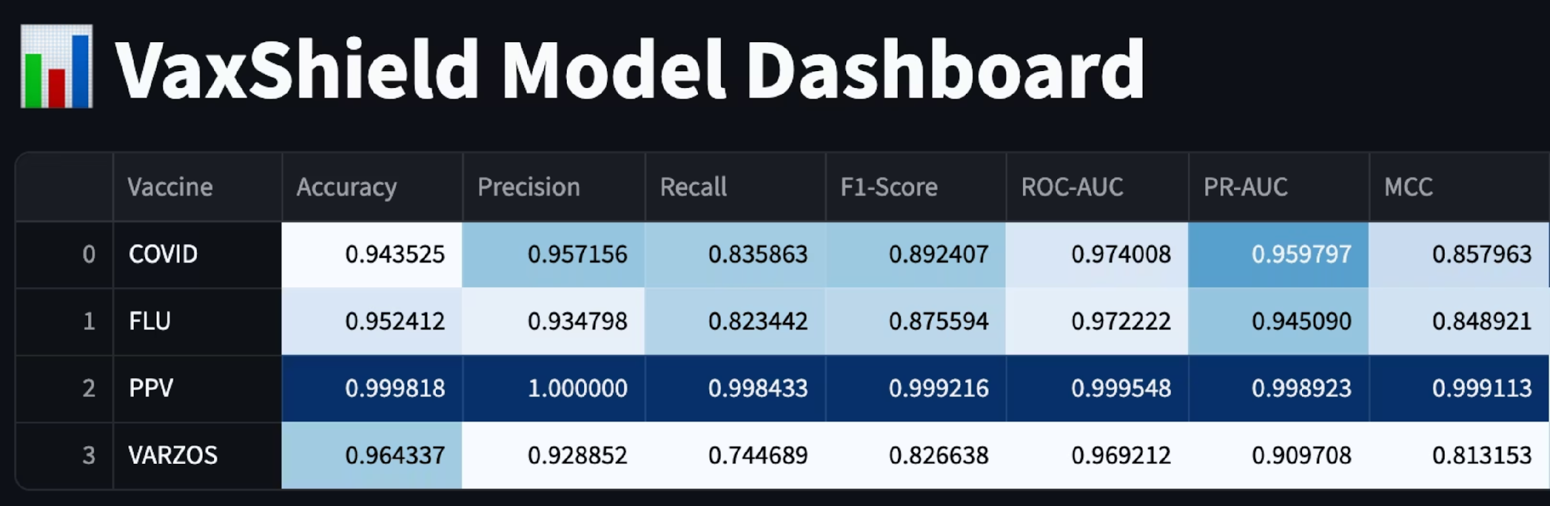
Final Performance: CatBoost vs. XGBoost
PR-AUC Comparison Across All Vaccine Models
CatBoost delivered significant improvements in PR-AUC across all four vaccine models. The focus on PR-AUC as the key evaluation metric demonstrates superior handling of imbalanced data, which is critical in pharmacovigilance where serious adverse events are rare but high-impact.

Slide 12





VaxShield AI System Architecture
End-to-End ML Pipeline Design
Frontend Layer
NLP Processing
Interactive Streamlit web application for user input
Feature extraction and entity recognition
Model Selection
Prediction Output
Route to appropriate vaccine classifier
Severity score and classification
Model Layer: Four dedicated CatBoost classifiers (.sav format) trained separately for COVID, Flu, PPV and Varzos vaccines

Slide 13
Deployment: Streamlit Interface
Real-Time Prediction Platform
Key Features
Technology Stack
Built using Streamlit framework for rapid deployment and interactive capabilities
Framework: Streamlit
Deployment: Web-based application
Accepts natural language input describing reported adverse events
Response Time: Real-time
Provides instantaneous feedback with predicted seriousness scores
User-friendly chat interface designed for healthcare professionals and researchers

Slide 14




NLP Deep Dive: Entity Extraction
Converting Unstructured Text to Structured Features
Challenge
Solution
User reports contain misspellings, abbreviations, and vague descriptions of symptoms
Fuzzy matching algorithms combined with custom regex patterns for robust extraction
Extraction Targets
Result
Age, Sex, VAX_TYPE, and Symptom Keywords identified with high accuracy
Noisy natural language successfully transformed into structured CatBoost-ready features

Slide 15
Prediction Logic: Interpreting Seriousness Scores
From Raw Probability to Actionable Severity Levels
1
Model Output
2
Context Weighting
3
Severity Classification
CatBoost returns raw probability P(Serious) ranging from 0.0 to 1.0
Confidence score boosted by explicit mentions of severe outcomes (e.g., +0.15 for "hospitalized", "death", or "life-threatening")
Final score mapped to three levels: Mild (Score < 0.4), Moderate (0.4 ≤ Score < 0.7), Severe (Score ≥ 0.7)

Slide 16
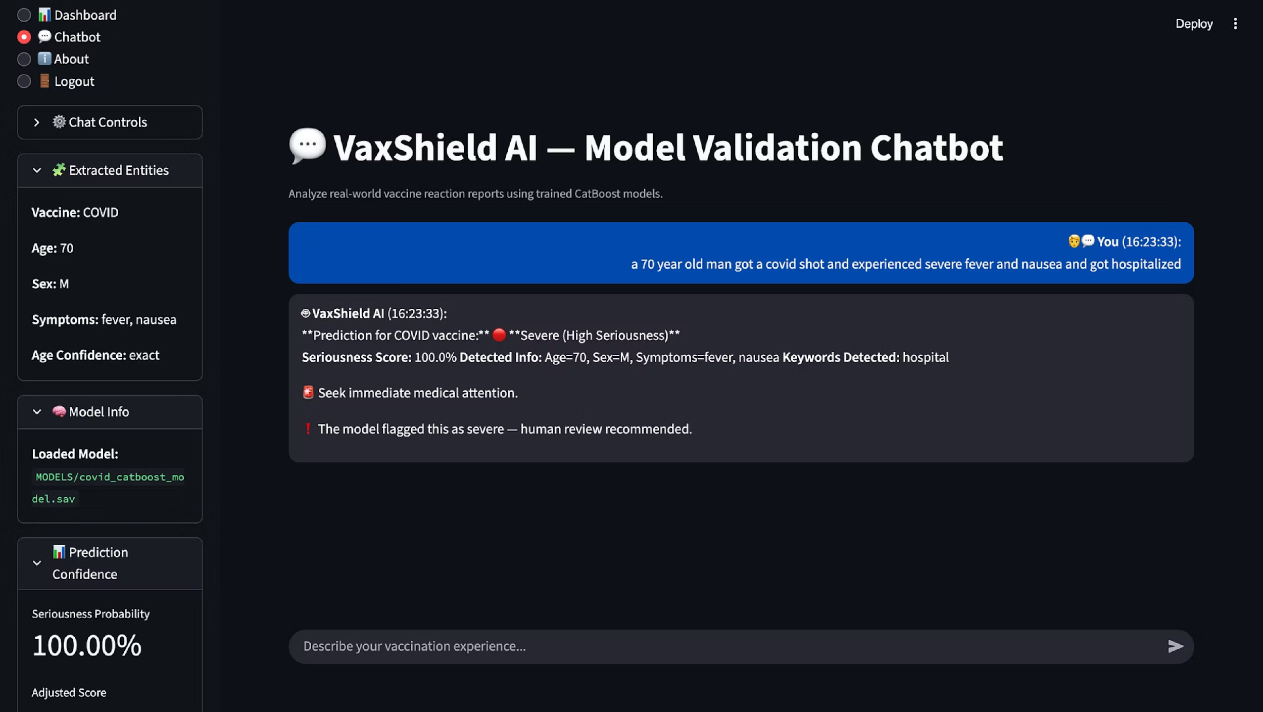
Demo Case 1: COVID Vaccine Validation
Model Validation Chatbot - Real-Time Prediction

Slide 17
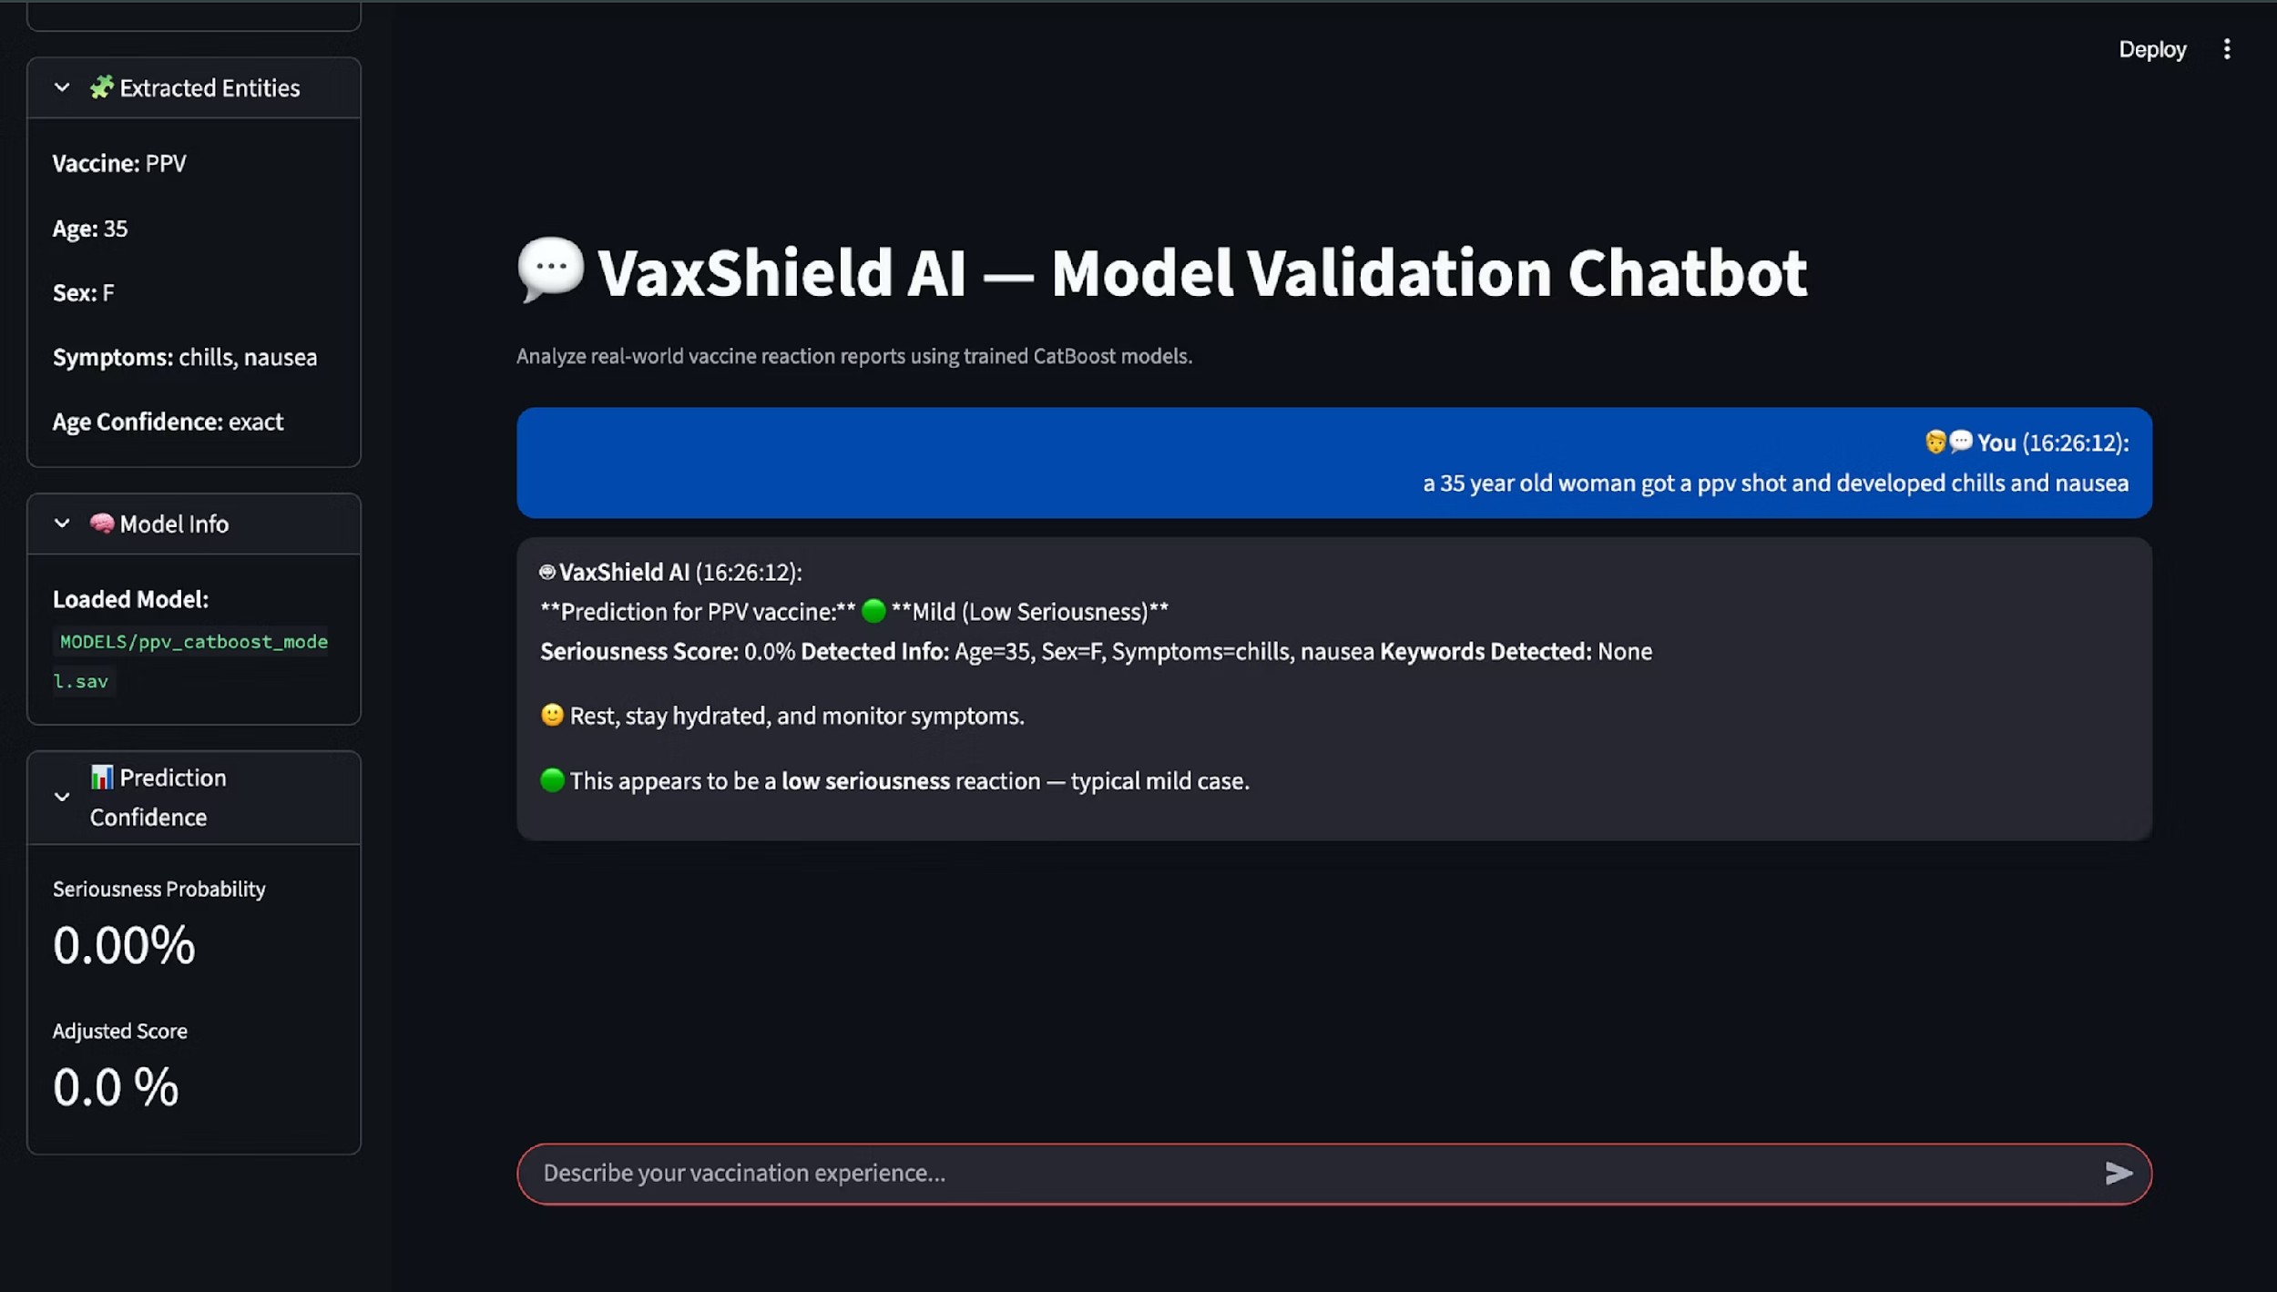
Demo Case 2: PPV Vaccine Validation
Model Validation Chatbot - Real-Time Prediction

Slide 18
Deployment Transparency: Debug Panel
Building Trust Through Explainability
Purpose & Benefits
Debug Panel Features
Increases user trust by exposing internal decision-making processes
Raw probability score from CatBoost model
Specific vaccine classifier used (COVID/Flu/HPV/MMR)
Aids clinical validation and model debugging during deployment
Entities extracted by NLP pipeline
Provides transparency required for healthcare AI applications
Context weights applied to final score
The sidebar debug panel serves as a critical transparency feature, allowing healthcare professionals to understand and validate the AI's reasoning process.

Slide 19
Capstone Achievement Summary
Model Performance & Methodology
Model Performance
Robust Methodology
Successfully implemented CatBoost achieving high PR-AUC scores (up to 0.96) with significantly improved Recall for imbalanced classification tasks
Developed end-to-end pipeline for handling mixed categorical and unstructured text data in pharmacovigilance applications
Deployment & Data Utility
Production Deployment
Data Utility Validation
Created functional, real-time interactive Streamlit application translating complex ML outputs into actionable severity levels for clinical use
Demonstrated practical utility of VAERS data for automated safety signal detection and adverse event monitoring

Slide 20
Deployment Success
Real-Time Functionality
Actionable Intelligence
VAERS Integration
Created a fully functional, interactive Streamlit application that operates in real-time, enabling immediate analysis of vaccine adverse event reports.
Successfully translated complex ML predictions into clear, interpretable severity levels that healthcare professionals can act upon immediately.
Demonstrated the practical utility of VAERS data for automated safety signal detection, proving the viability of AI-driven pharmacovigilance systems.

Slide 21
Responsible AI Use and Limitations
Correlation vs. Causation
Research-Only Scope
Data Imbalance Challenges
The model predicts the likelihood of seriousness based on patterns in data, not direct causal relationships between vaccines and adverse events. Clinical judgment remains essential.
Designed strictly for research and educational purposes. This tool is not a substitute for professional medical diagnosis, treatment decisions, or regulatory review.
Despite significant improvements through class weighting and ensemble methods, Recall optimization remains an ongoing area for enhancement in minority class detection.

Slide 22

Future Scope: Model Refinement
Optimization Strategies
Expected Impact
1
Advanced Imbalance Correction
2
Enhanced Explainability
These optimizations could improve Recall by 15-20% while maintaining high Precision, creating a more balanced and clinically useful model.
Apply SMOTE (Synthetic Minority Over-sampling Technique) to generate synthetic samples of serious adverse events, significantly improving Recall scores for minority classes.
Integrate SHAP (SHapley Additive exPlanations) values to provide local model interpretability, showing exactly which features drive individual predictions.
Feature Engineering
Expand feature sets to include temporal patterns, demographic interactions, and multi-vaccine exposure sequences for more nuanced predictions.

Slide 23



Future Scope: Platform Expansion
Multi-Vaccine Coverage
Expand model portfolio to include HPV, MMR, Hepatitis, and other routine vaccines, creating a comprehensive safety monitoring ecosystem across the entire vaccination schedule.
Continuous Monitoring
Integrate live VAERS API feeds for automated data ingestion and continuous model retraining, ensuring predictions remain current with emerging safety signals.
Deployment Scalability
Explore alternative platforms like Gradio or cloud-native solutions for enhanced accessibility, including potential mobile deployment for field use by healthcare providers.

Slide 24
References: Data & Standards
VAERS Database
MedDRA IME Criteria
CDC Vaccine Safety
Primary data source for vaccine adverse event reports and safety signal detection analysis
Standardized terminology for Important Medical Events used in severity classification
Comprehensive overview of COVID-19 vaccine safety monitoring systems and protocols
https://vaers.hhs.gov/data/datasets.html
EMA IME List Documentation
https://www.cdc.gov/vaccine-safety/vaccines/covid-19.html

Slide 25
References: Algorithms & Research
Methodological Foundations
Domain Context
CatBoost Algorithm: Ordered boosting methodology for gradient boosting with categorical features
Vaccine Safety History: Historical context on vaccine side effects and adverse event monitoring
ML in Pharmacovigilance: Application of machine learning techniques to post-market drug safety surveillance
Recent Research: Contemporary studies on COVID-19 vaccine safety surveillance methodologies
History of Vaccines - Side Effects FAQ
CatBoost: Ordered Boosting Paper (2017)
Scientific Reports (2022) - Nature
Machine Learning in Pharmacovigilance (PMC)

Slide 26
Thank You
VaxShield AI — Empowering Data-Driven Vaccine Safety

